Slide 1
RUNGE KUTTA METHOD

Slide 2
The Runge Kutta 4th Order method is designed to find out the numerical solution of a first order differential equation. It is a kind of initial value problem in which initial conditions are known, i.e the values of x₀ and y₀ are known, and the values of y at different values x is to be found out.

Slide 3
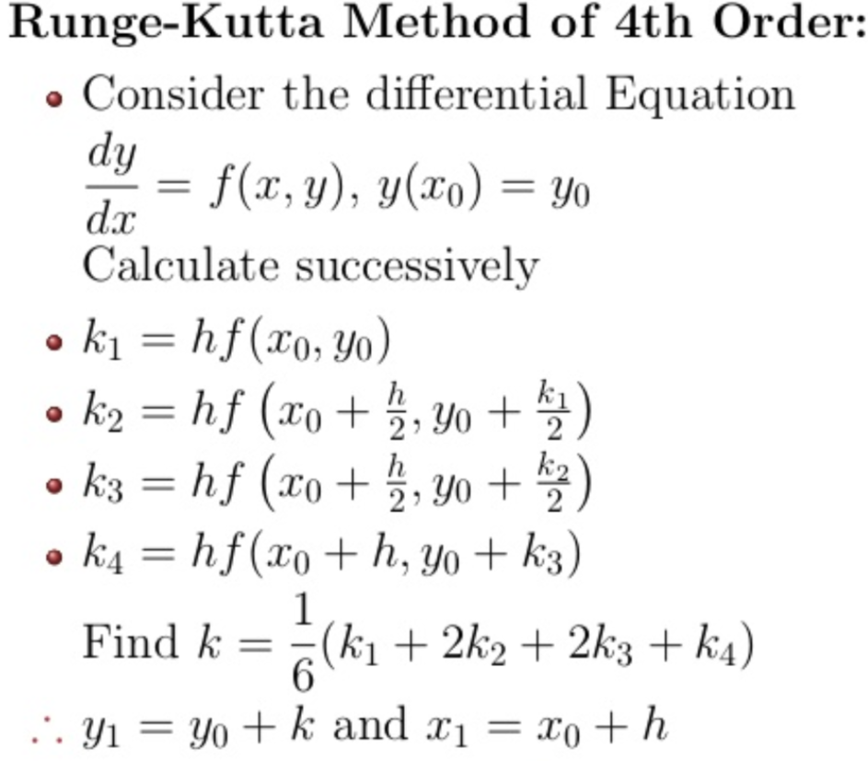

Slide 4
Pseudocode for Runge Kutta’s method
Step 1: Define Function f(x,y)
Step 2: Read/input initial given values x0,y0
Step 3: Read/Input step size h, xn (for which function is to be evaluated)
Step 4: while x<xn
k1 = h*f(x0,y0)
k2 = h*f(x0+h/2 , y0+k1/2)
k3 = h*f(x0+h/2 , y0+k2/2)
k4 = h*f(x0+h , y0+k3)
k = (k1+2*k2+2*k3+k4)/6
y = y+k
x = x+h
Step 5: Display x and y

Slide 5
Implement RK method in C.
The Students are encouraged to develop an optimized code.

